Slide 1
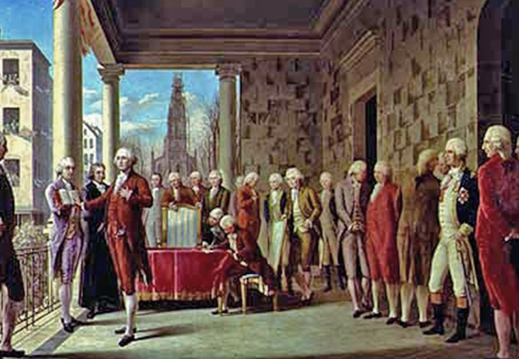
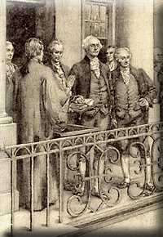
The Inauguration of George Washington
New York City (Capitol) April 30th, 1789
Two areas to take note of:
What personality traits does Washington display?
How do you think this will reflect on his as President?

Slide 3
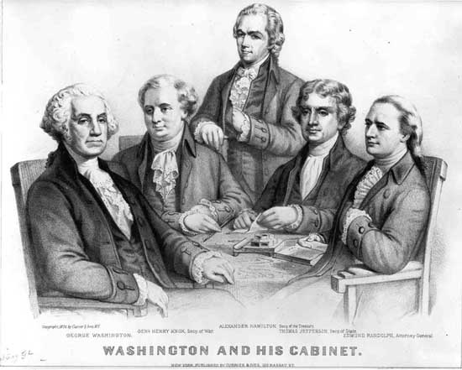
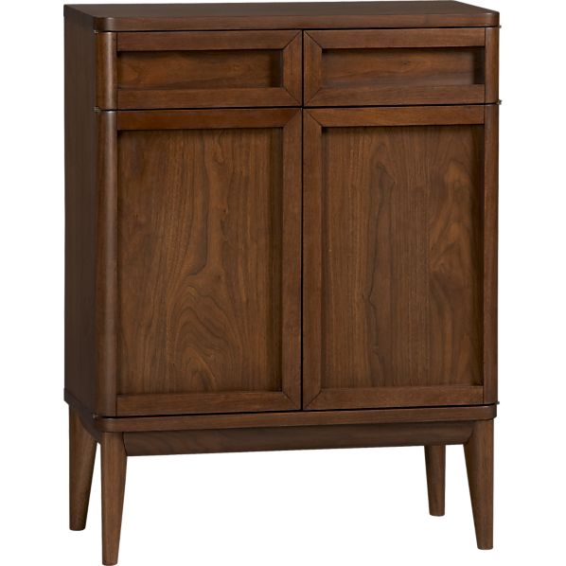
What is a ‘Precedent’
Precedent- a standard which others follow
One major precedent set by Washington was establishing a ‘cabinet’ (group of advisors to help him run the country)

Slide 4
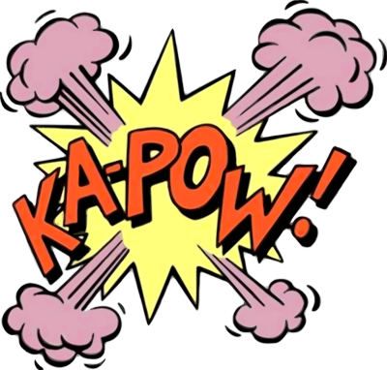
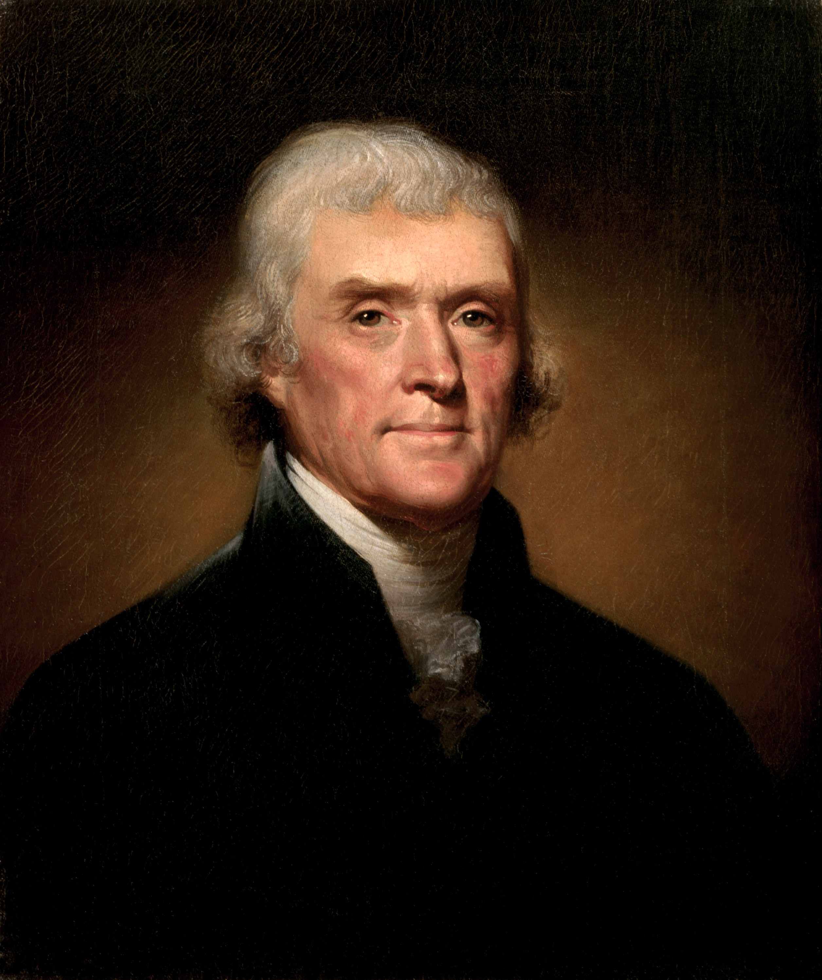
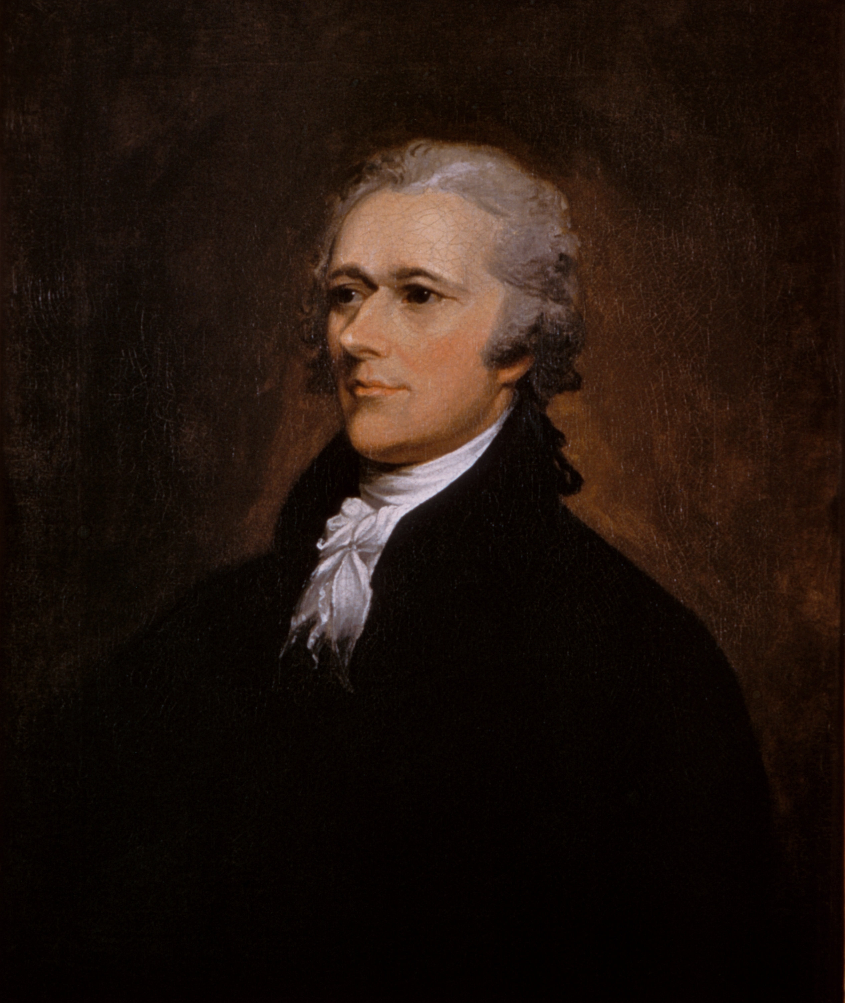
The Big 2
Thomas Jefferson, Virginia, Anti-Federalist
Alexander Hamilton, New York, Federalist
VS
Secretary of State
Secretary of Treasury

Slide 5
Jefferson
Hamilton
Born to a debtor in the Caribbean, little parental involvement
Lawyer and farm-owner
Well educated in math, architecture, philosophy, etc.
Fought in the Revolution and was Washington’s aide
Helped write Declaration
Was N.Y. Representative at the Constitutional Convention
Was minister to France during Constitutional Convention (successor to Franklin)
Wrote 51 of the 85 Federalist Papers
Thought minority wealthy members of the country were taking control at the expense of the masses.
Economic genius!...but a little paranoid of the poor masses
Rich should govern because “not all men are angels.” Gov. should protect people from themselves
Soft spoken, not a great speaker
Called “idealistic and a dreamer” by critics.
Very vocal about beliefs and practical
Jefferson said he was “dangerously aristocratic”

